Slide 1
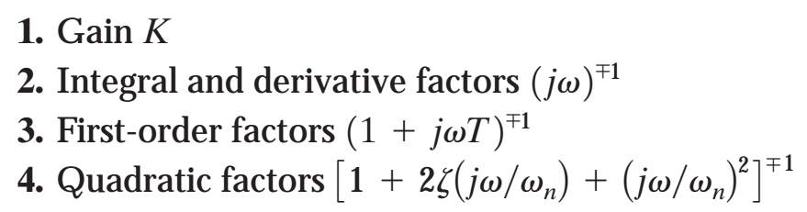

Slide 2
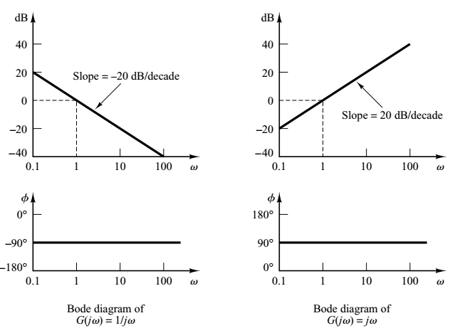

Slide 3
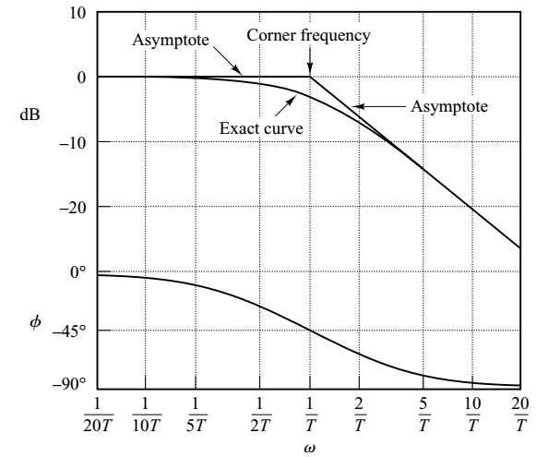

Slide 4
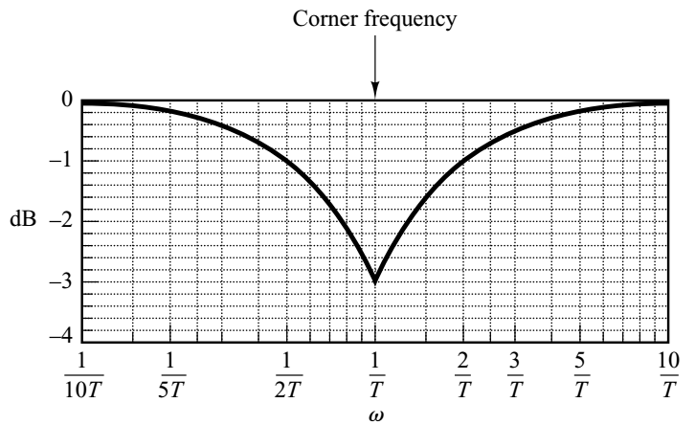
The error at corner frequency (1/T) = -20 log sqrt(1 + 1) + 20 log 1 = -3.03 db
At one octave below and above the corner frequency the error is -0.97 db
At onc decade below and above the corner frequency the error is -0.04 db
The errors as systematic and not much. Therefore, use of asymptotes is
convenient to draw the Bode sketch.
Above graph can be used to make corrections in the sketch for accuracy.

Slide 5
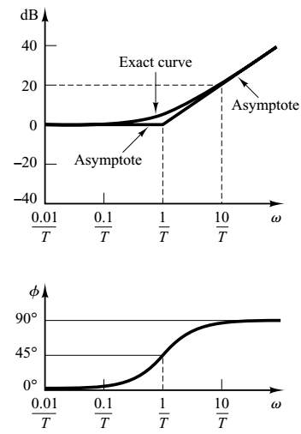

Slide 6
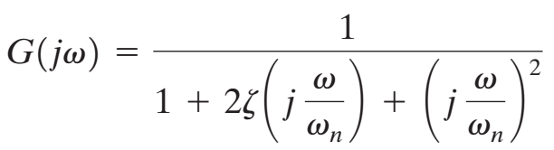
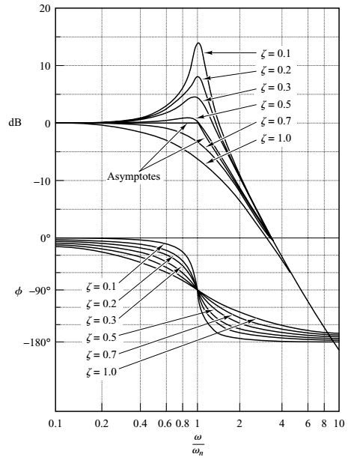
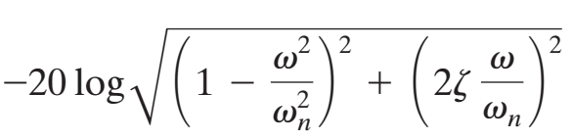

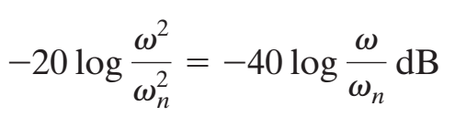
Log magnitude of G (jω)
At low frequencies ω << ω _{n}
At high frequencies ω >> ω _{n}
- 40 db/decade is the slope of asymptote for high freq.

Slide 7
Corner frequency is at ω _{n}
The error at corner frequency increases
with damping
For low value of damping the asymptotes
approximate the exact curve well.

Slide 8
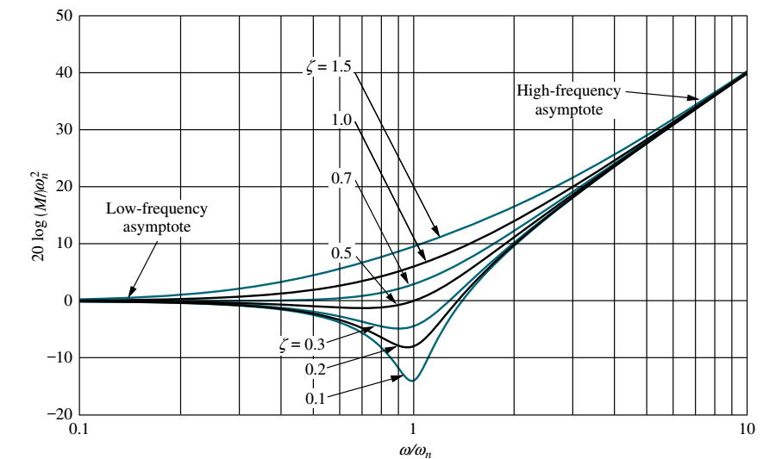

Slide 9
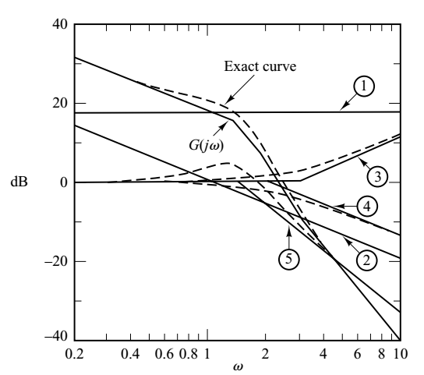

Slide 14
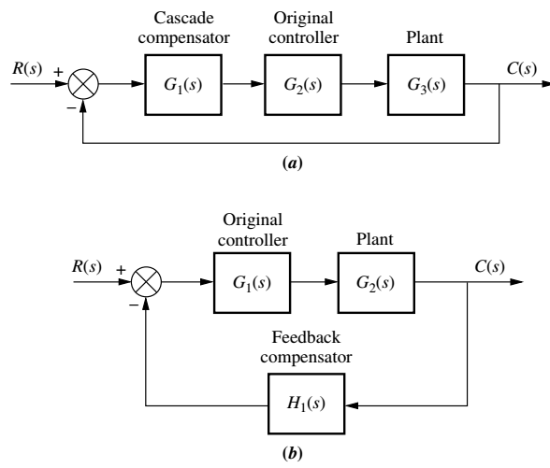
(a) Series compensator, (b) Feedback or parallel compensator

Slide 15
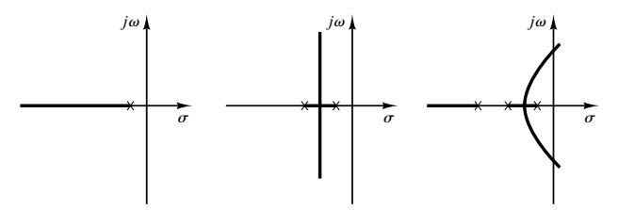

Slide 16
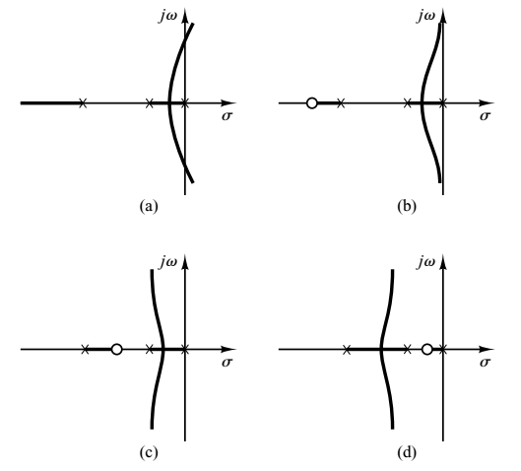

Slide 17
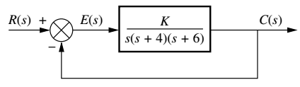
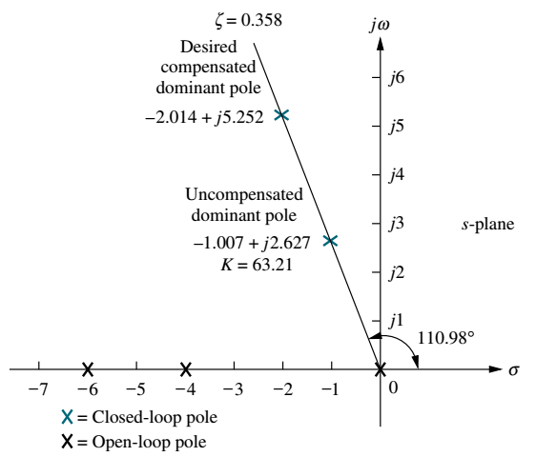
Design lead compensator to reduce settling time by
factor of 2 maintaining %OS = 30.
Lead compensator has TF of the type (s + z)/(s + p)

Slide 18
1. 30% OS implies 0.358 damping ratio (use formula)
2. For uncompensated system, dominant pole is -1.007+ j 2.627
3. T_{s} = 3.972 sec.
4. Design point T_{sd} is corresponding to 1/2 T_{s} = 1.986 sec.
5. For the same damping (%OS) and design T_{sd} new real part is
-ζω_{n} = - 4/T_{sd} = - 2.014 and the imaginary part ω_{d} = 5.252.

Slide 19
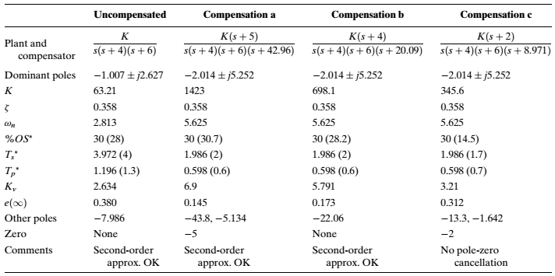
Lead compensator has TF of the type (s + z)/(s + p)

Slide 20
